Slide 1
web development project
“mihawk”
RASHID ALI 229217 BCA(1 SEM)

Slide 2
index
Introduction
Objective
Implementation of project
Source code
output
Conclusion
bibliography

Slide 3
objective
The objective of the website is to entertain the viewers by the means of anime
“ANIME” is a hand-drawn and computer-generated animation originating from Japan.
ANIME is getting its fans from all over the world. The main reason why anime became so popular is because it is so versatile. It can be used to tells us different stories .

Slide 4
SOFTWARE TOOLS
SUBLIME – To create the homepage using HTML & CSS
HTML COLOR PICKER –To pick the suitable colors to be used in the homepage
BOOTSTRAP- Used for CSS framework
GOOLE FONTS –to pick various fonts style for the homepage

Slide 5
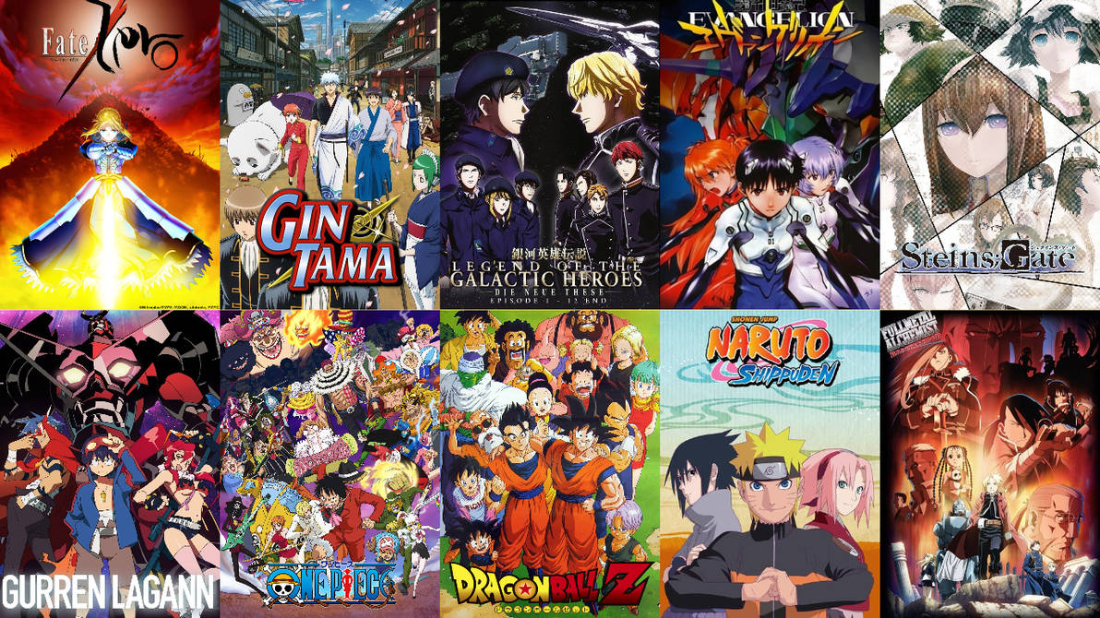
Implementation of the project

Slide 6
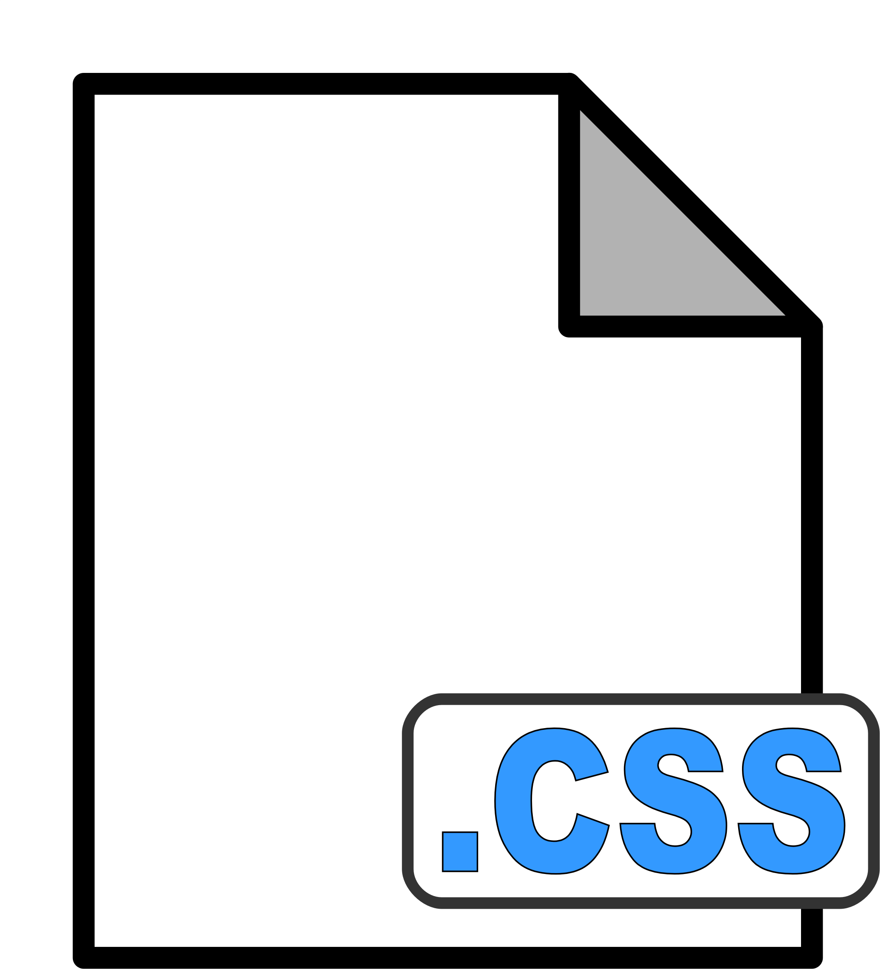


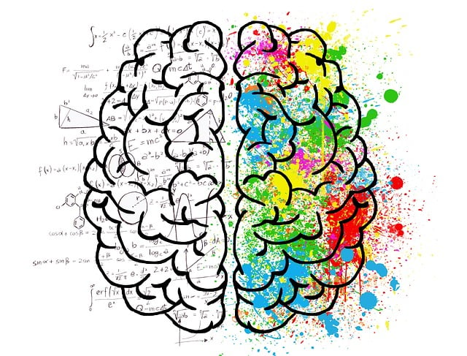
Steps of implementation
CSS
CSS (cascading style sheets) like html is essential for this project .using this we designed the overall website
RESEARCH
Had to do a lot of research in order to collect data ,absorb new ideas
HTML
Adequate knowledge of
HTML (hyper text markup language)is required .Using this we create the basic structure of our website
WRITING
When all is said and done .What remains is for you to write the code
EXECUTION
Executing the code we will have our website prepared

Slide 7
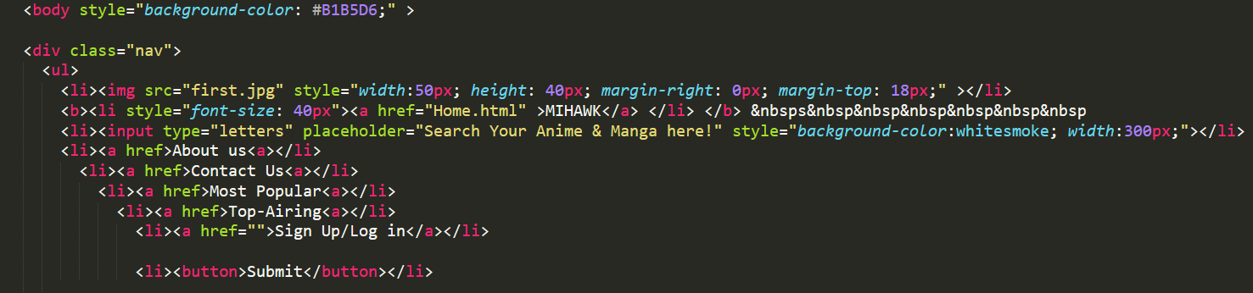
Source code
html

Slide 8
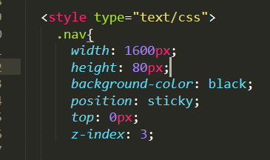
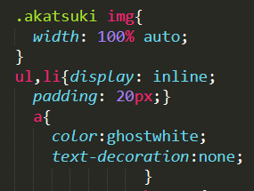
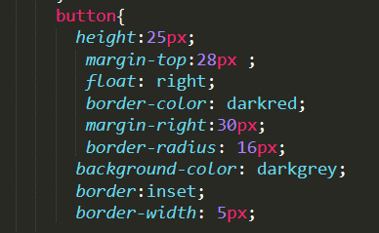
css

Slide 9
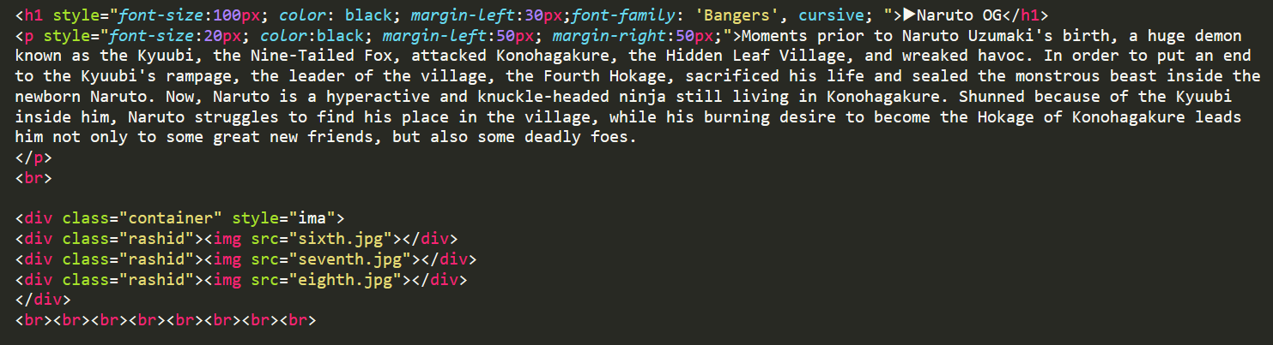

Slide 10
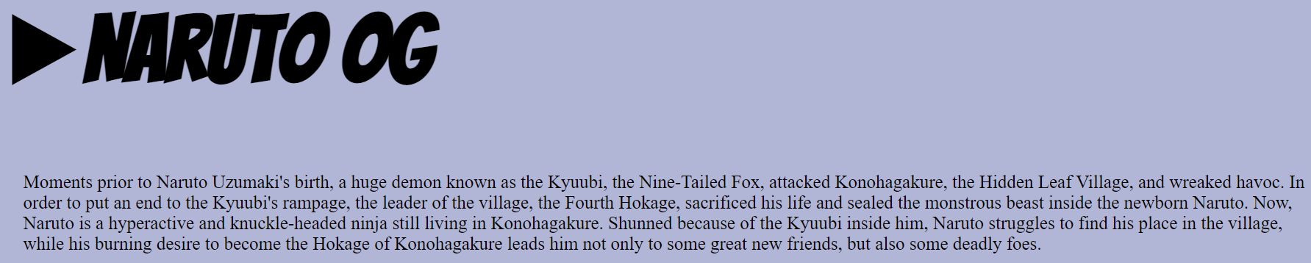
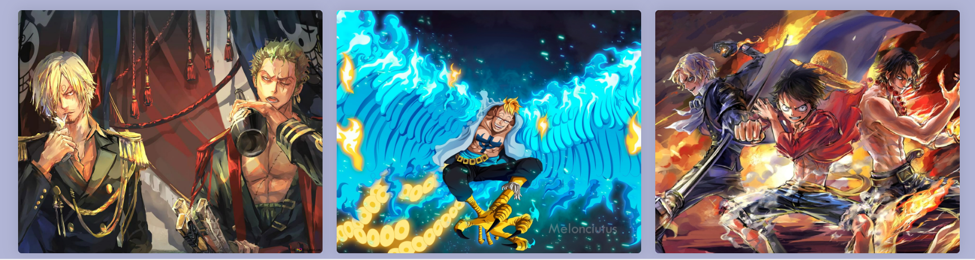
output

Slide 11
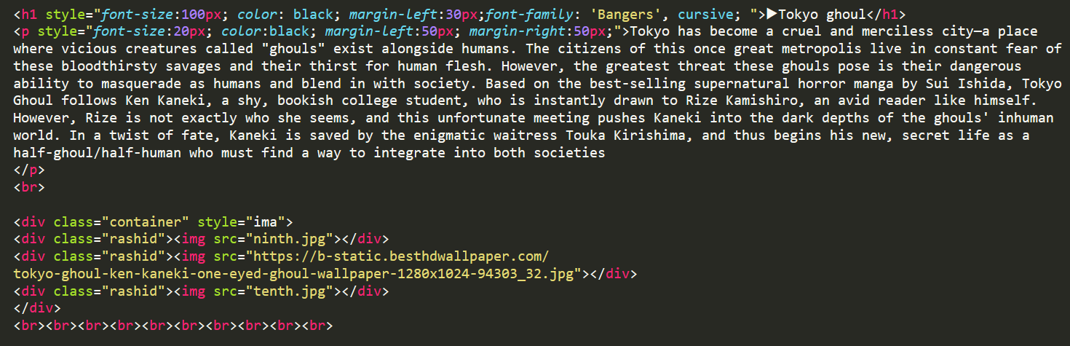

Slide 12
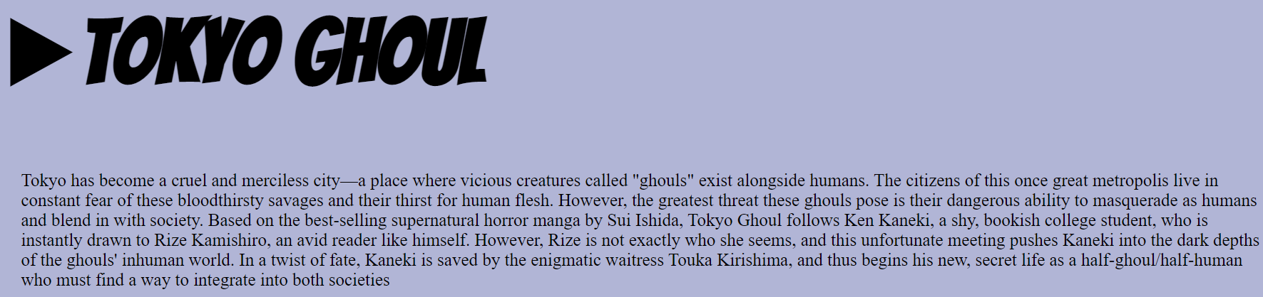
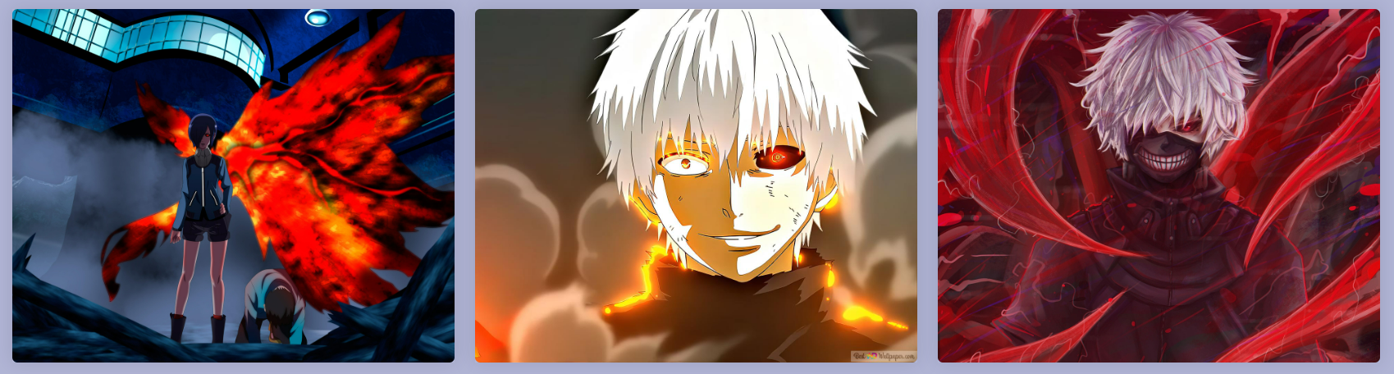

Slide 13
conclusion
I learned the following things from the project
HTML (hyper text markup language)is required .Using this we create the basic structure of our website
CSS (cascading style sheets) like html is essential for this project .using this we designed the overall website
Types of css ( inline , external , internal )

Slide 14
bibliography
From my own notes
Help is taken from an anime website
www.zoro.to
www.chrome.com
www.youtube.com

Slide 15
THANK
YOU

